Slide 1

Beat Alzheimer's PHONE + I’M CONFUSED app
- Amanda and Gaurav

Slide 2

Main problem for patients
Background Information
**Too many messages**
-They are extremely forgetful
-They suffer from dementia/disorientation
-Emotional problems- depression, frustration and clinging
-Cannot stick to a schedule
Notes:
The story is that they arent going to call 1000 ppl and order things and get spams and forget bc can only contact 5 ppland no internet

Slide 3
Our Journey & Goals
Research on symptoms of an Alzheimer's patient
Real stories of patients with Alzheimer’s narrated by their loved ones
Documentaries like “The Alzheimer’s Project”
to build a device that is easy to handle especially for the patients
to improve the life of the caretakers, without overwhelming them
Wanted to get rid of the complexity that comes from current technology for the patient

Slide 4
Our Solution
To build a simple phone (for the patient) that will help patients and their caretakers
The phone has 3 basic functions -call -text -I’m confused
The caretakers connect to the phone through the I’M CONFUSED APP -track the patient’s day to day activities and whereabouts
Helps patients come back to reality in case they feel lost
Simplifies life for the patient and the caretakers

Slide 5
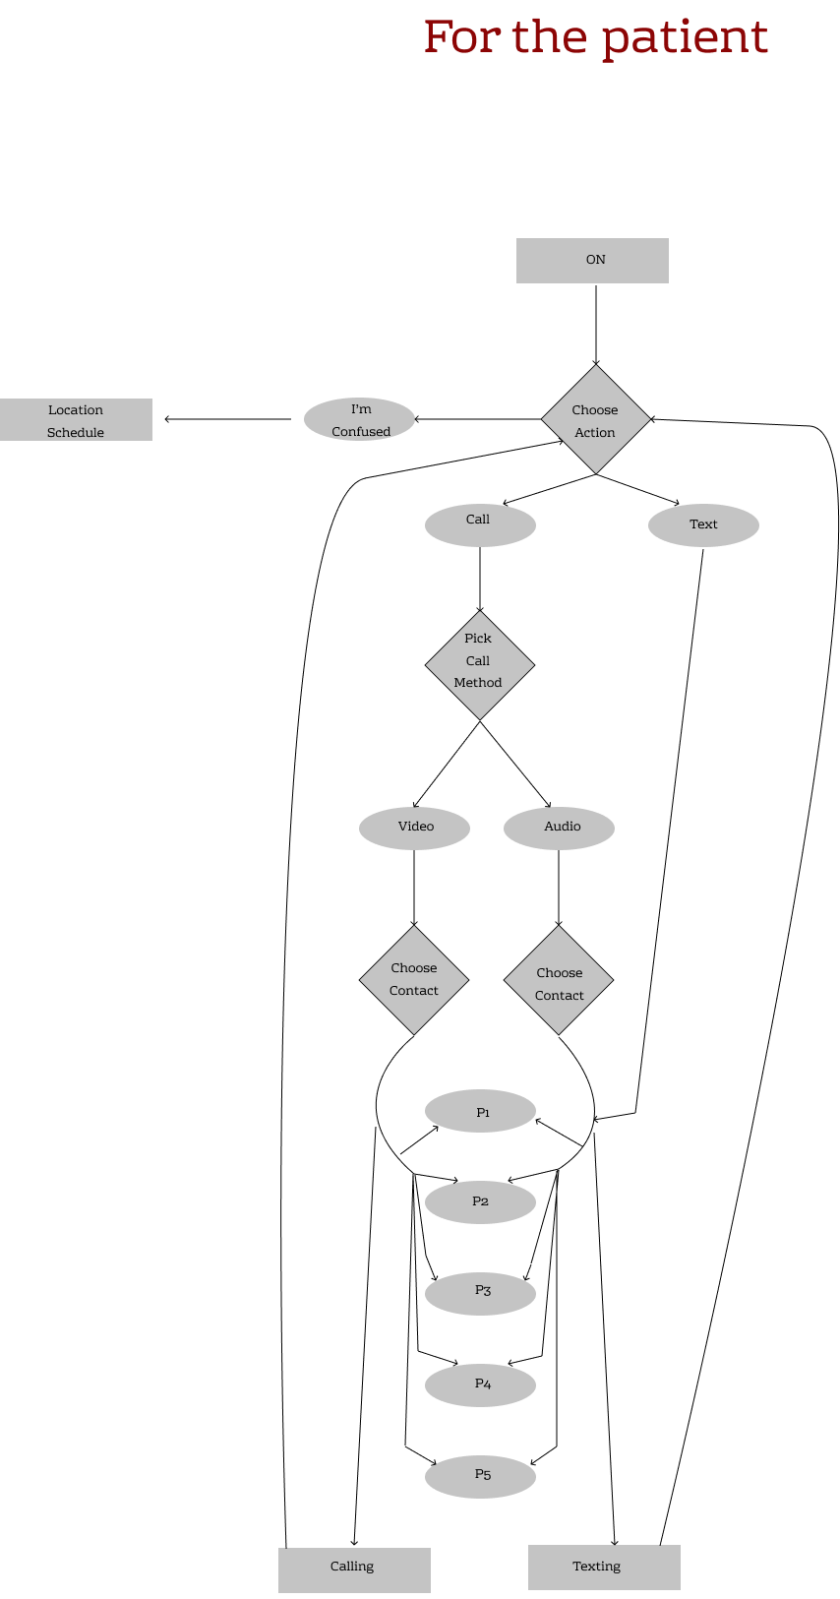
Materials and Software Used:
Sketch and Figma
Elements Envato
Patient
Workflow for phone:

Slide 6
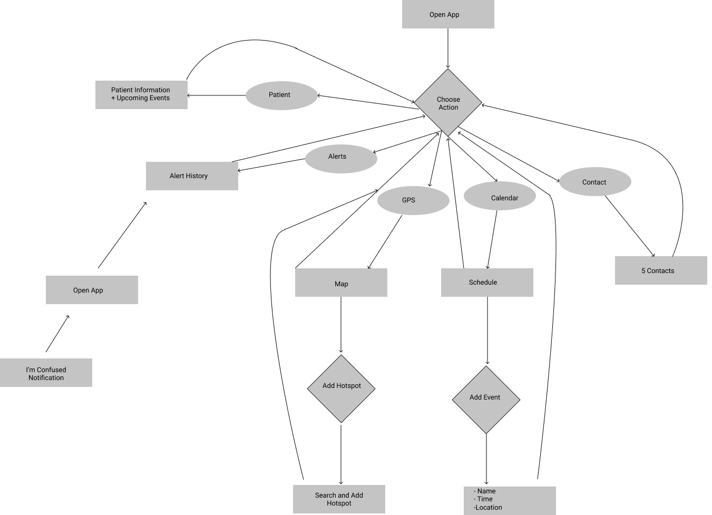
Caretaker Workflow for APP:

Slide 7
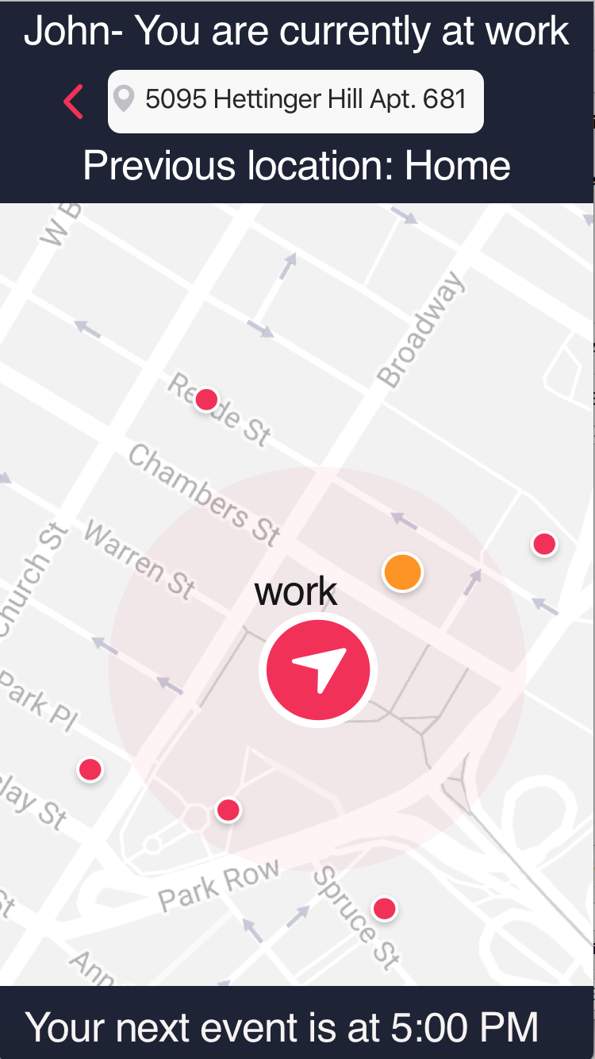
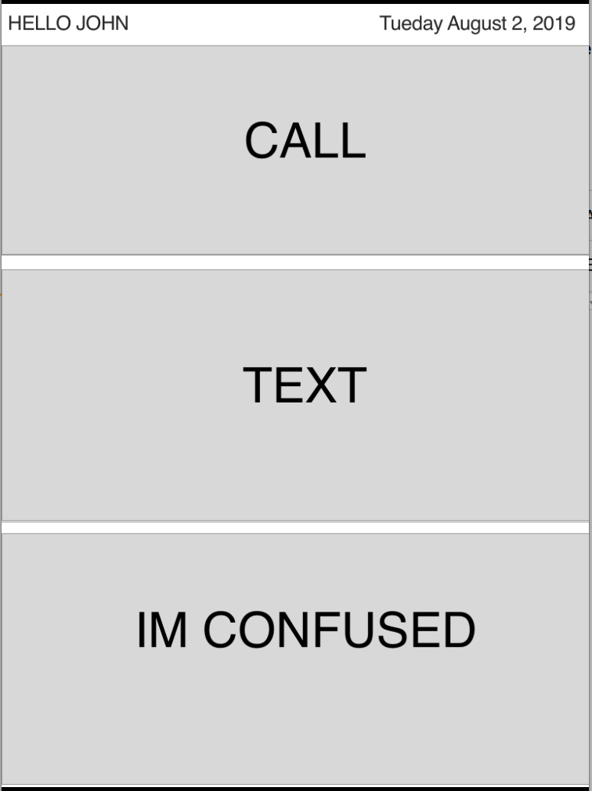
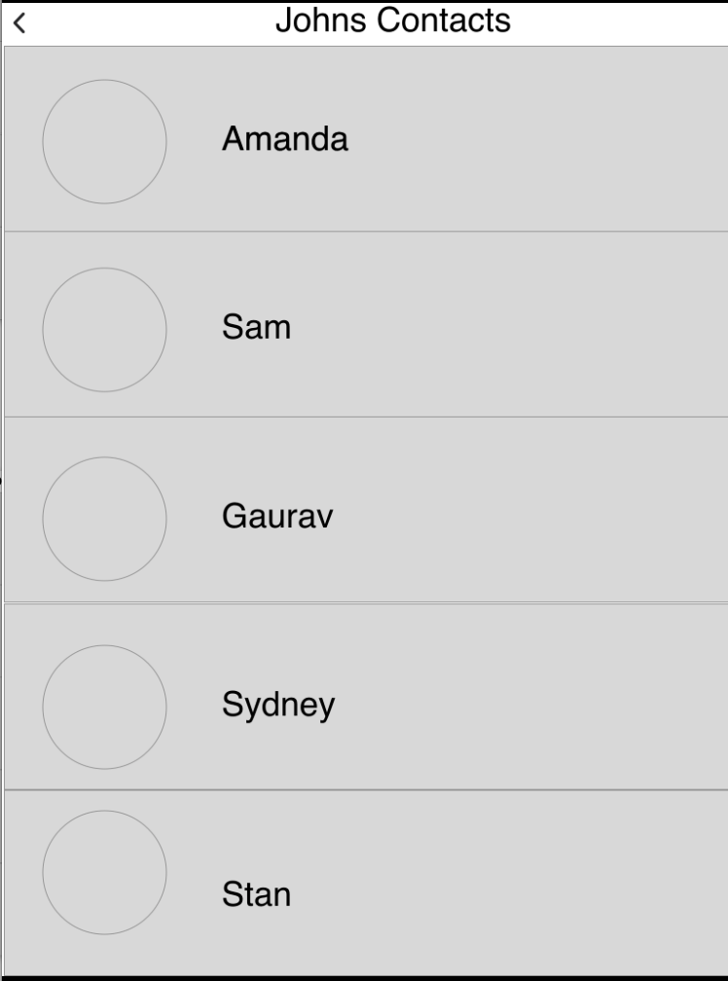
How does our device help the patients?
Beat Alzheimer's PHONE can connect 5 caretakers (caretakers set this up through the up) – Get’s the patient connected to their caretakers
Caretakers can keep track of the patient and contact them if they are in the wrong location
Broadcasted info: -Addresses by name in a familiar voice -Gives the patient detailed description of where they are + their previous location (where they came from)
The patients are informed about their schedule according to the calendar and what to do next (caretakers set up through app)

Slide 8
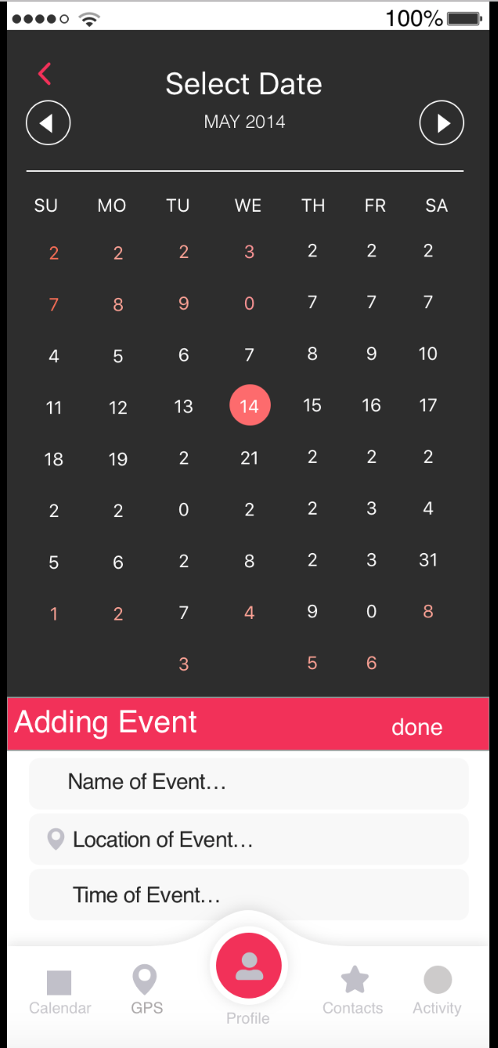
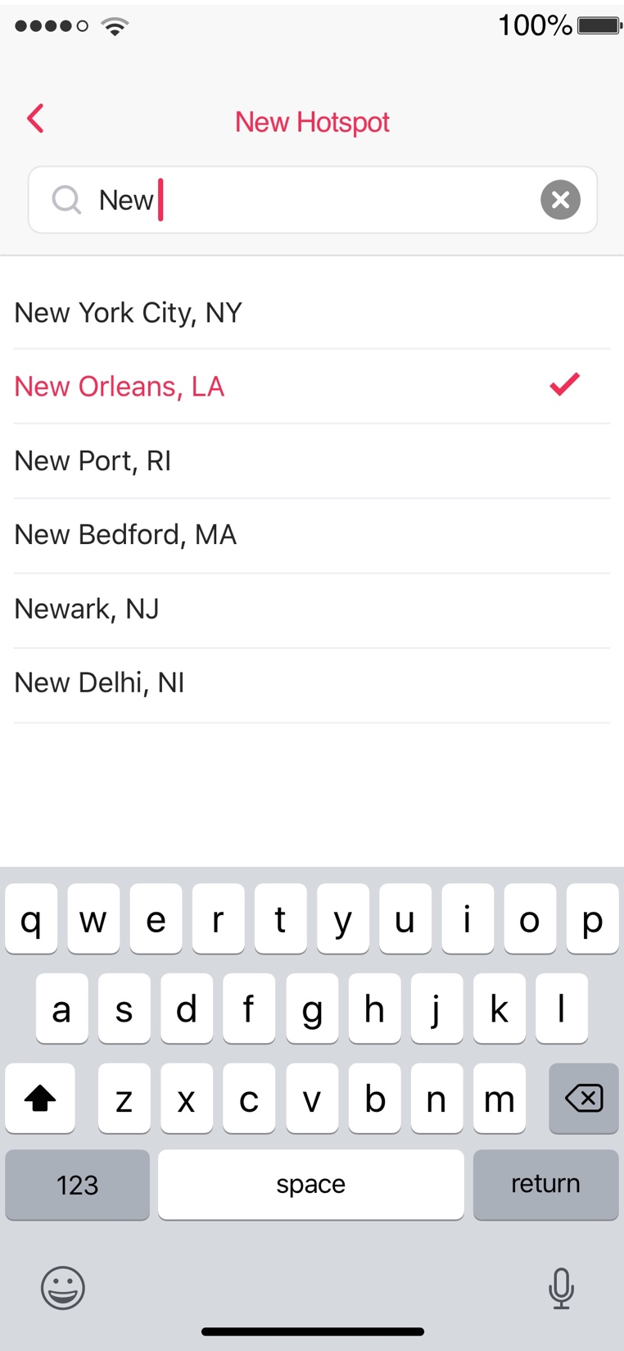
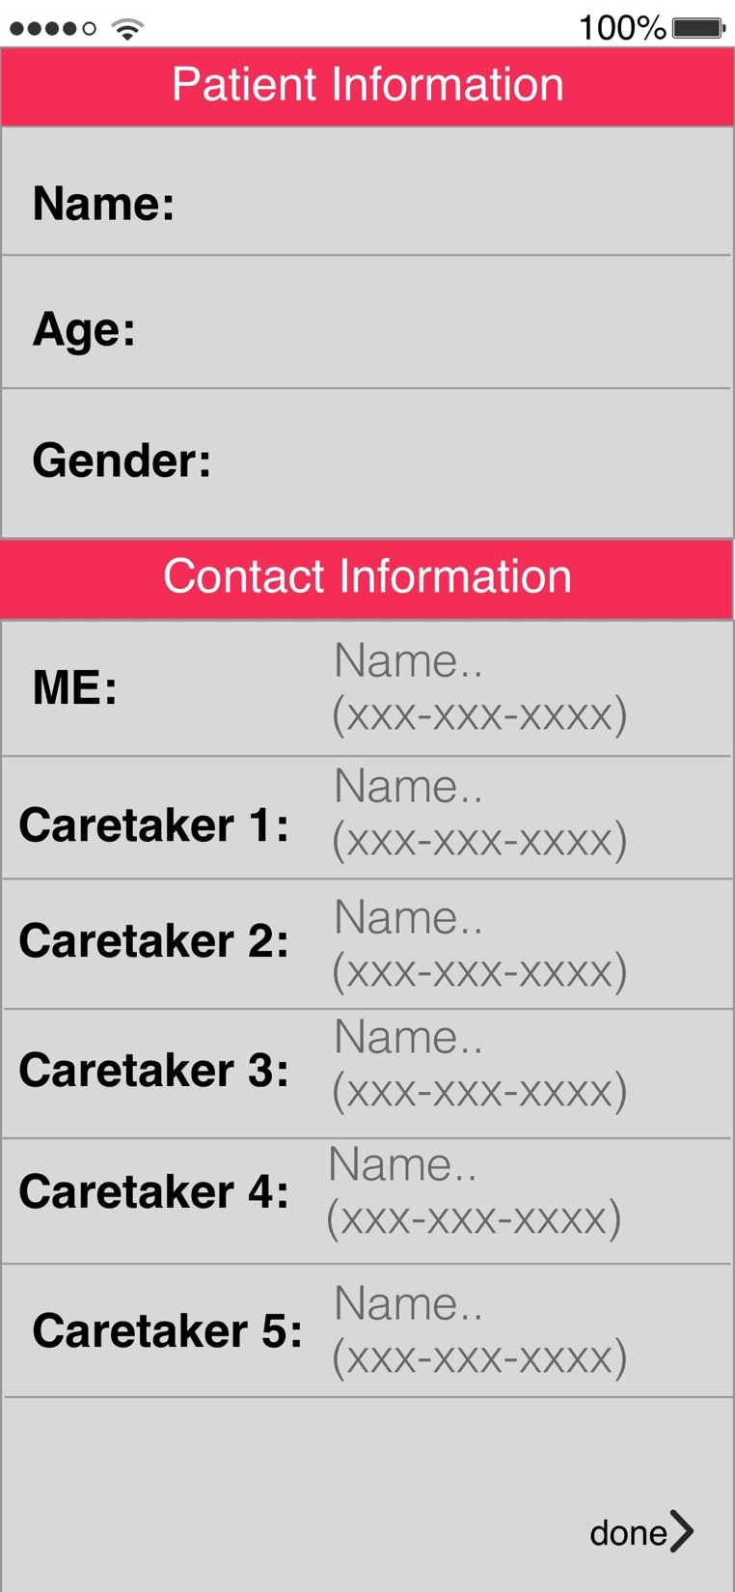
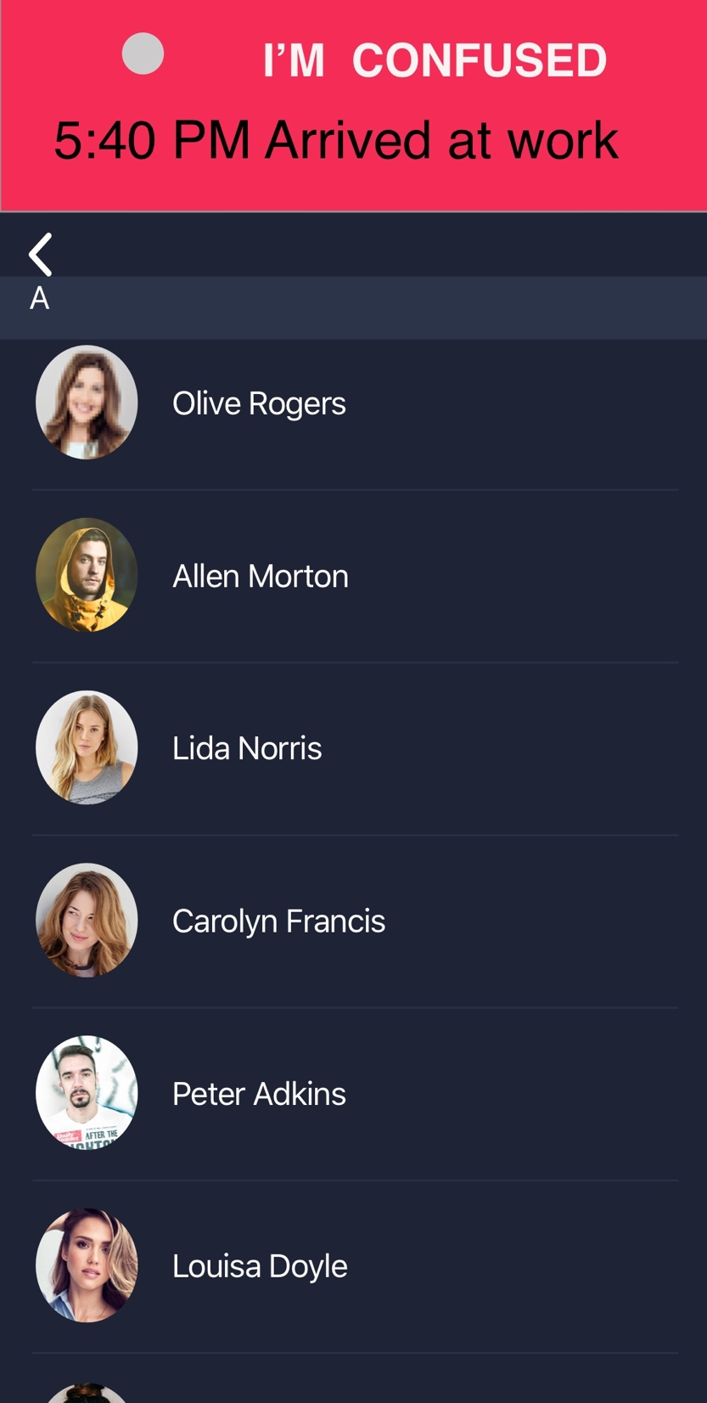
How does it help the caretakers?
They can keep track of the patient’s location by adding hotspots
It will keep them aware of the patient’s activities and if they are attending those activities
It will control contact information for the patient

Slide 9
User Testing:
Scenario 1: Add a hotspot through the I’m Confused Application -key for the app in identifying if John is where he should be
Scenario 2: Check on John’s upcoming events
-important so the caretaker can remind the patient and update the calendar
Scenario 3: See if John showed up at work through the app
-the caretaker should be able to track the patients arrivals to hotspots or key locations on the calendar by going to the patients “ACTIVITY”

Slide 10
Improvements
Solar Power is not efficient: We want come up with a battery like those in the old phones that last 2- 3 days when fully charged.
We want to come up with a cover for the phone that also acts as a charger as soon as the battery of the phone falls below 20%
We want to come up with a nano-sensor that sounds some sort of an alarm if the patient moves 30m away from the phone so that the patient doesn't lose the phone
We want to make this phone a satellite phone so that patients can contact the caretakers from almost anywhere

